Slide 1
Skill Verse
LMS with Intelligent Task Planner
From enrollment to completion—AI that plans, nudges, and keeps learners on track
CSE 327-Software Engineering
Group #12:
1.Nafiz Imtiaz - 2222044042
2.Mahadi Hasan Nayan - 2222130042
TO DO
IN PROGRESS
DONE

Slide 2
Outline
1
Motivation and Problem Statement
2
Similar Solutions and Gaps
3
Proposed Solution Overview
4
Requirement Analysis
5
Feasibility Analysis
6
UML Diagram
7
Technical Implementation
8
Timeline & Gantt Chart

Slide 3
Introduction & Motivation
WHAT
An LMS fused with an AI-powered task planner
WHY
Learners juggle courses, deadlines, and life—disorganization causes drop-offs; educators lack insight into disengagement
HOW
AI breaks down work, schedules it intelligently, syncs with calendars, and nudges learners to completion
IMPACT
Increase course completion and on-time submissions • Boost educator visibility into engagement

Slide 4
Similar Solutions & Gaps
Feature | Canvas/Moodle | Coursera/edX | Trello/Notion | Our LMS
Course Delivery | ✓ | ✓ | – | ✓
Calendar | ✓ | ✓ | – | ✓
AI Planning | – | – | – | ✓
Cross-course Priority | – | – | – | ✓
Educator Analytics | ✓ | – | – | ✓
OUR DIFFERENTIATION
• End-to-end integration from course metadata to analytics
• AI-driven task breakdown and intelligent scheduling
• Smart cross-course prioritization engine
• Bi-directional calendar synchronization
• Deep educator insights into task-level engagement

Slide 5
Proposed Solution Overview
Turn course goals into a living plan that schedules itself and adapts
EDUCATORS
LEARNERS
Create/sell courses • Manage content • View engagement analytics
Enroll & learn • Manage tasks on Kanban board • AI assistance
Course Modules
AI Task Gen
Smart Schedule
Reminders
Analytics
INTEGRATIONS
✓ Google Calendar (bi-directional)
✓ Payment providers (Stripe)
✓ Email notifications
📅
💳
📧
🤖
Calendar
Payments
Email
AI

Slide 6
Intelligent Task Planner (AI)
AGENTIC BEHAVIOR
CONTROLS & TRANSPARENCY
🤖 Breaks assignments into subtasks
✓ User approval of generated plans
📊 Schedules by urgency & effort
✓ Editable priorities & constraints
⚡ Detects 'falling behind' patterns
✓ Study hours per day settings
🎯 Proposes catch-up plans
✓ Change log: 'What & why'
🔕 Avoids notification fatigue
✓ Full plan visibility
DATA INPUTS
Deadlines • Course workload • Engagement patterns • Calendar events • User preferences • Past performance
Planner Agent
Priority Engine
Scheduler
Calendar/ Notifications

Slide 7
Requirement Analysis
Functional Requirements
Non-Functional Requirements
• User auth (Learner/Educator roles) and profiles
• User-Friendly Interface
• Course creation, modules/lessons, pricing, publishing
• Fast & Responsive Experience
• Secure purchase and enrollment
• Security & Data Privacy RLS in database
• Task board with tasks linked to content
• Reliability & Scalability
• AI-generated task suggestions and breakdowns
• Google Calendar bi-directional sync
• Reminder emails for deadlines/study sessions
• Educator analytics (enrollment, completion, engagement)
• Learner productivity insights (time, streaks)

Slide 8
Feasibility Analysis
Technical Feasibility
Tailwind v4 + Framer Motion [UI Design and Animation]
Next.js 15 App [Fast rendering and clean code architecture]
@supabase/ssr Client [Cloud database, Authentication, Cookie session handling]
Operational Feasibility
Clear Role Separation [Educators and learners distinct dashboards]
Intuitive visual design [User Adoption & Minimal Training]
Automated Security Guarding [Next.js Middleware handles route protection]
Seamless Workflow Integration [synchronization with Google Calendar and notifications]
Economic Feasibility
Open-Source Stack [Next.js, Tailwind CSS, TypeScript, Lucide Icons are completely open-source]
Free-Tier Managed Services[Supabase, OpenRouter]
Low Operating Costs [Serverless deployment (e.g., Vercel)]

Slide 9
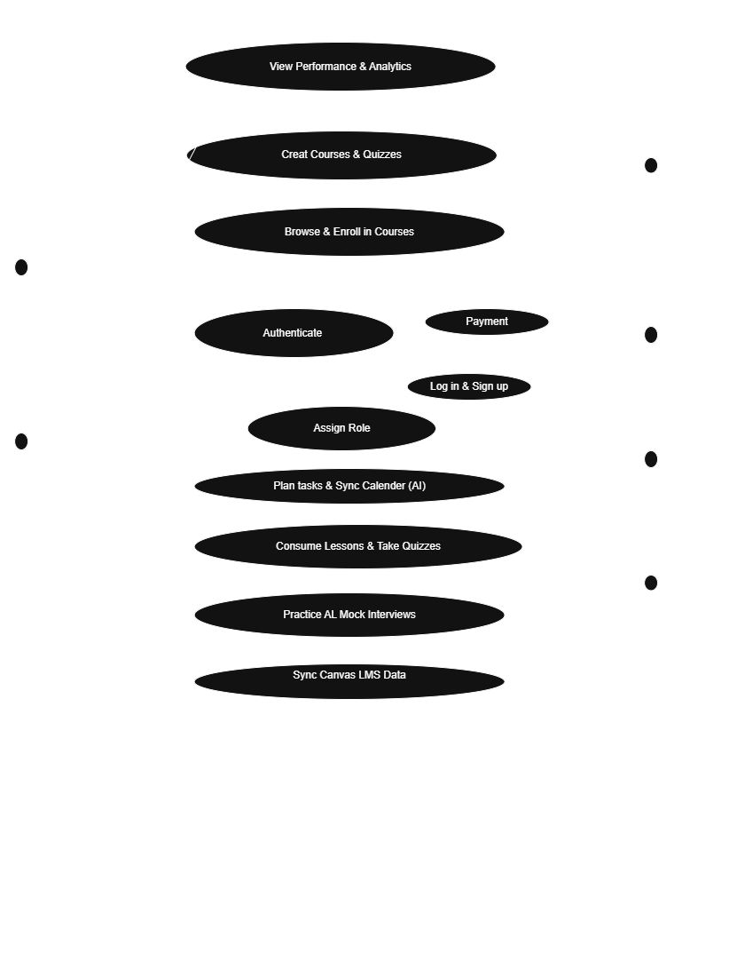
UML Diagram
Use Case Diagram of our system

Slide 10
Technical Implementation
TECH STACK
ARCHITECTURE
Frontend
Next.js 15, React, Tailwind CSS
Next.js App
API/Edge Fn
Backend
TypeScript, Supabase (Postgres, Auth, Storage)
Postgres
LLM/AI
AI
OpenRouter for LLM access
Integrations
Google Calendar, Stripe, Email
Ext APIs
AI PLANNING PIPELINE
1. Extract Metadata
2. LLM Generate
3. Priority Engine
4. Schedule Slots
5. User Approval
6. Sync & Remind
SECURITY & DATA
🔐 RBAC by role + RLS policies per tenant/user
🔑 Signed URLs for media • Server-side secrets • Rate limiting on AI endpoints
📊 Core entities: User, Role, Course, Module, Lesson, Enrollment, Task, Plan, Payment, ActivityLog

Slide 11
Timeline & Gantt Chart
Phase
W1
W2
W3
W4
W5
W6
W7
Discovery/Design
0Auth2.0 + Database
Core LMS
Task Board MVP
AI Planner v1
Calendar & Notifications Sync
Analytics
External Integrations [Canvas, Open Router]
Testing
Pilot & Present

Slide 12
Thank You

